Slide 1
BRAIN ECG SIGNAL DETECTION USING MACHINE LEARNING IN PYTHON

Slide 2
Team Members:
Vishnu Vardhan Reddy Vangala – 700739149
Nihal Bonkanpally – 700740922
Sainath Reddy Kollu – 700740523
Vemireddy Venkata Narayana Reddy – 700741289

Slide 3
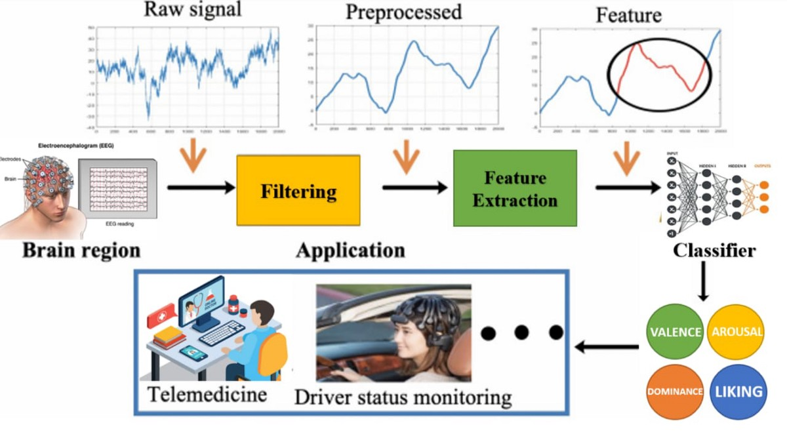
Introduction
Global modernization
Machine learning
Electrophysiological action
Postsynaptic potentials
Postsynaptic perspective
Pyramidal cellular apical dendrites
Notes:
Technology is a major contributor to global modernization, which is gaining popularity worldwide. In the near future, additional precise approaches will be available to simplify the process. When the potentials of adjacent neurons are put together, "postsynaptic potentials" are created by brain activity. It's a worldwide symbol for Nerve fibre's "electrophysiological action" here on "cerebral cortex" or "scalp," which captures brain activity's electric wave changes. Postsynaptic "pyramidal cellular apical dendrites" generate brain waves.

Slide 4
Background
Brain-computer interfaces
Development of BCI
Electroencephalography (EEG)
Locked-in syndrome
Close proximity
Nonselective transmission mechanism
Notes:
With "brain-computer interfaces" (BCIs), a new generation of technology that can be controlled by mental energy rather than just physical muscles is expected soon. Using "neuroimaging technology," BCI can be controlled by translating mental activities into inputs. Electroencephalography (EEG) has substituted invasive methods for assessing cerebral activity. "Locked-in syndrome" people can't speak, so they can't communicate clearly. Pyramidal cell apical nerve cells create brain waves through utilisation. The nonselective transmission pathway between the brain and thalamus causes synchronised EEG rhythm. Electroencephalograms support neuroscience research.

Slide 5
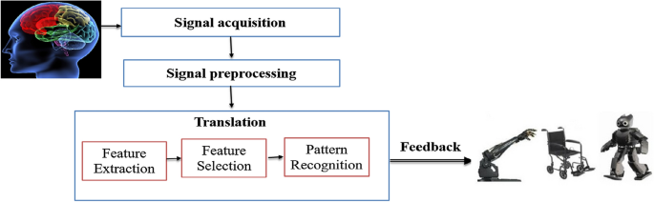
Motivation
Capability to detect variations in brain
Beneficial in the diagnosis
System caused by a head trauma
Neurological symptoms
Psychotic symptoms, and narcolepsy
Evaluate trauma, drug intoxication
Notes:
The electroencephalogram (EEG) can identify differences in cognitive function that may help diagnose brain diseases, such as epilepsy or seizure diseases. EEGs may help detect or cure brain lesions. Brain trauma. ECG is used to improve channelling and detect brain strain. Throughout medical treatments, an EEG can measure brain blood flow. More incentives could encourage doctors to recommend an EEG. EEGs can provoke seizures in patients prone to them. The evaluation may involve flashing lights or deep breaths, which elevate heartbeat and respirations.

Slide 6
Objectives
To get a deep knowledge of python.
To adopt the different machine learning algorithms of python.
To develop a python code that will be used to detect the brain EEG signals with the help of machine learning.
To examine the ECG signal properties to see whether they can differentiate between different mental states.
To research and clinical testing as a specific characteristic for diagnosing mental exhaustion.
Notes:
The basic objective of this study is to use computer vision and the Python programming language to create a programme that can identify the "EEG signals" that are being generated by a neural network. This will be performed so that the study's principal aim can be met. By using the right ideas and strategies in the right way, us hope to reach the destination.

Slide 7
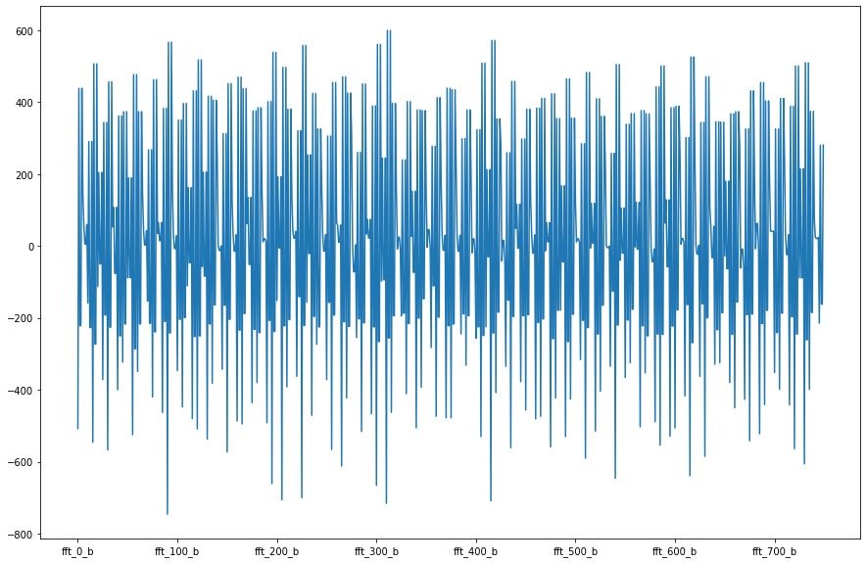
Related work
Eye-tracking technologies
Categorise mental weariness
Toeplitz inverse covariance-based clustering
Support vector machine
Heart rate variability (HRV)
K-nearest neighbour (KNN) classifier
Single-channel ECG equipment
Naive bayes (NB), and logistic regression (LR)
Causal convolutional neural networks (cCNNs)
Notes:
Researchers employed "Toeplitz inverse covariance-based clustering" (TICC) for multi-level psychological exhaustion analysis and the "support vector machine" (SVM) for classification. This study only can include a narrow set of individuals, therefore its findings could not be generalised. EEG and HRV were examined to determine the impact of sustained mental activity on the two nervous system branches. Researchers were capable of correctly classifying EEG signals using a KNN classifier. These findings confirm using EEG data to determine mental fatigue. In another experiment, researchers employed T-shirt ECG data and machine learning classifiers to develop an autonomous mental stress recognition system. Highest-quality model was 94.1% efficient. This study only looked at psychological trauma, thus it may not function for mental fatigue.

Slide 8
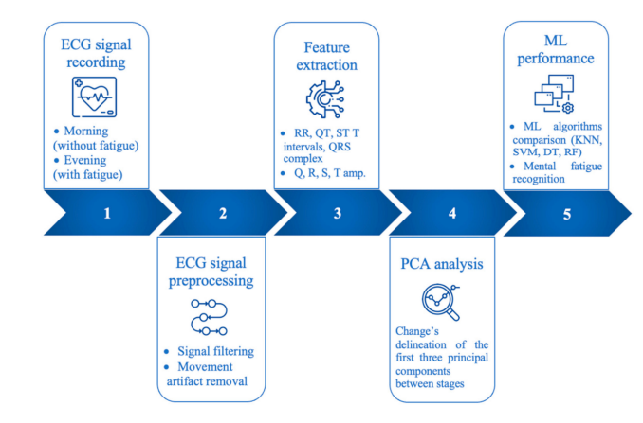
Proposed framework
Physical and mental health conditions
Unsupervised learning
Semi-supervised learning techniques
Precise observed values
Bagged decision trees
DT prototypes and RF configuration
Repeated cross-validation
Notes:
Machine learning (ML) technologies are used to build efficient algorithms for processing large volumes of data. Many ML approaches are available for data prediction and categorization. Three types: Popular supervised learning algorithms include SVM, KNN, DT, and RF (RF). Unsupervised learning involves clustering and neural networks. Semi-supervised learning includes SVMs, multiple regression analysis, and other techniques. "Unsupervised learning" can discover patterns from unlabeled data, while "supervised learning" assesses labelled data to formulate predictions or organise the data. Like any classifier, a random forest needs training and testing data. More data improves Machine Learning classification. Regularisation of training data can impact prediction accuracy in ML techniques. Cross-validation prevents overfitting. This strategy organises data to determine classifying performance.

Slide 9
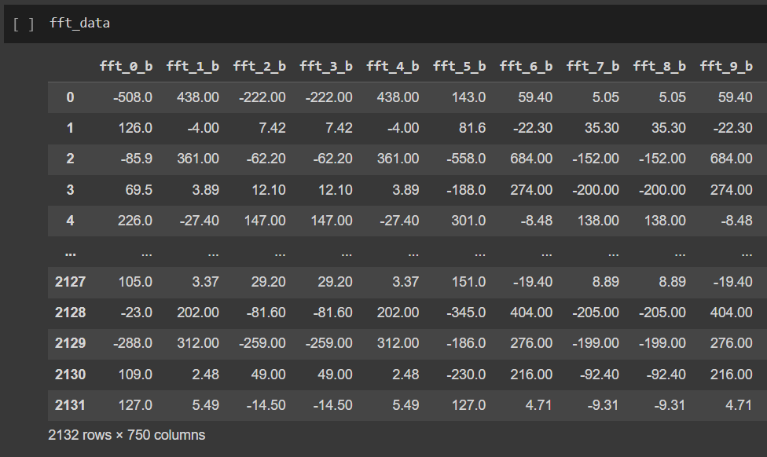
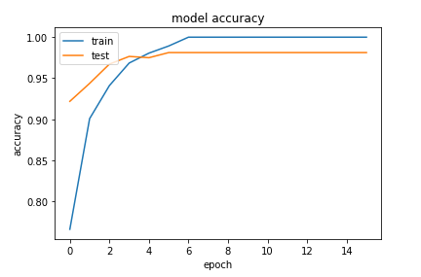
Data description
Brainwave data
Ground-breaking approach of statistical extraction
Two distinct individuals
Muse EEG headgear
TP9," "AF7," "AF8," and "TP10 EEG placements
Notes:
After examining the dataset, a model will be constructed that accurately represents the data across all key attributes. Here we present "brainwave data" extracted from an electroencephalogram (EEG) using the novel statistical method. The EEG was used to gather the information. Data was gathered from two persons (one male and one female) in each region over the course of three minutes (positive, neutral, negative). Researchers used "Muse EEG headgear" equipped with dry electrodes at TP9, AF7, AF8, and TP10 sites to capture EEG data. In addition, information is gathered for six minutes, which represents the amount of time people spend in a balanced resting state.

Slide 10
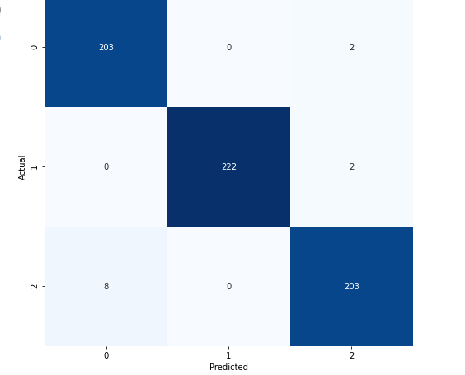
Result
Numpy, Sklearn, Pandas, TensorFlow, and Seaborn
Google's TensorFlow
TensorFlow API
Checking the null values
Model accuracy analysis
Model loss analysis
Confusion matrix analysis
Notes:
The application's primary libraries and their efforts are listed. Numpy, Sklearn, Pandas, TensorFlow, and Seaborn were utilized for the project. Python lists may be less space-efficient and slower than NumPy arrays. Arrays are less heap and easier to manage than other database systems. Length and dtype are derived from null values. All factors have been checked it against value, and the price and its parameters have been explained. 95.550% is the reliability score. Evaluation and general accuracy assessment are right, hence consequence analysis is accurate. This section shows how training and experimental research work with the right model. Because trained and test data are various colors, the graph shows the correct output. The example given details the confusion matrix. We've been valuable and truthful.

Slide 11
Reference list
Datta, S., 2022. Brain signal recognition using deep learning (Doctoral dissertation, Brunel University London).
Rana, A. and Kim, K.K., 2022. FPGA Implementation of an Artificial Intelligence Signal Recognition System. Journal of Sensor Science and Technology, 31(1), pp.16-23.
Medhi, K., Hoque, N., Dutta, S.K. and Hussain, M.I., 2022. An efficient EEG signal classification technique for Brain–Computer Interface using hybrid Deep Learning. Biomedical Signal Processing and Control, 78, p.104005.
Ma, X., Wang, D., Liu, D. and Yang, J., 2020. DWT and CNN based multi-class motor imagery electroencephalographic signal recognition. Journal of Neural Engineering, 17(1), p.016073.
Narin, A., 2020. Detection of focal and non-focal epileptic seizure using continuous wavelet transform-based scalogram images and pre-trained deep neural networks. Irbm.
Varandas, R., Lima, R., Bermúdez i Badia, S., Silva, H. and Gamboa, H., 2022. Automatic cognitive fatigue detection using wearable fNIRS and machine learning. Sensors, 22(11), p.4010.

Slide 12
Thank you

